Slide 1
CA LAB(2)

Slide 2


Slide 3
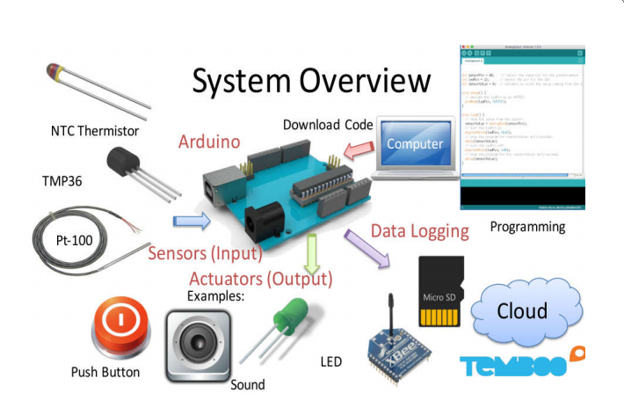

Slide 4
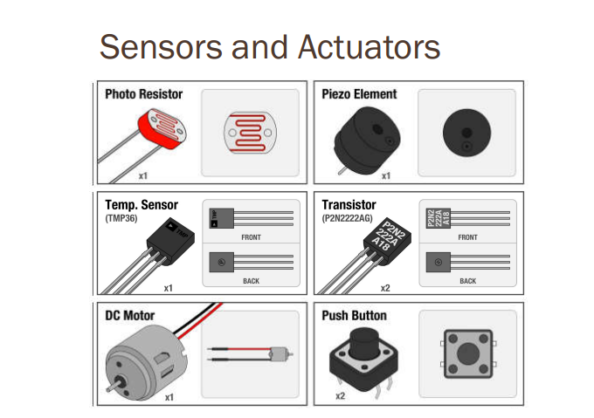

Slide 5
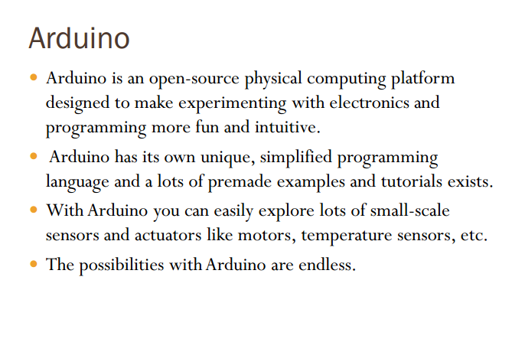

Slide 6
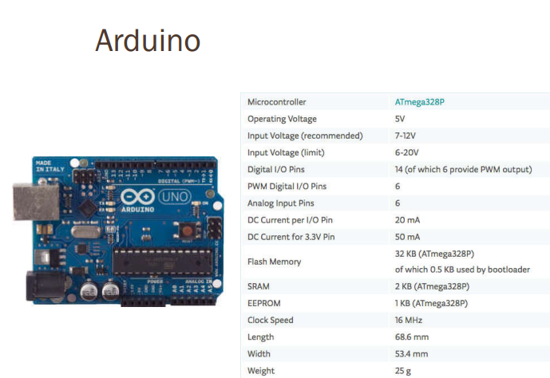

Slide 7
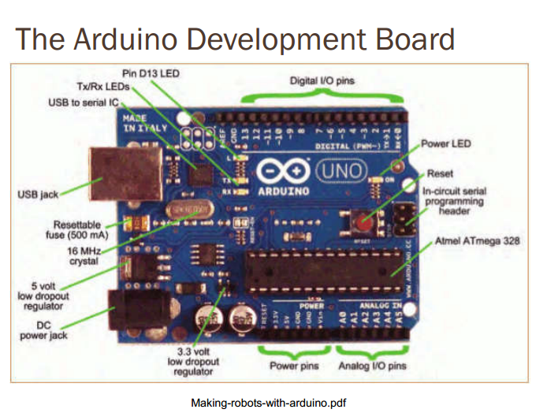

Slide 8
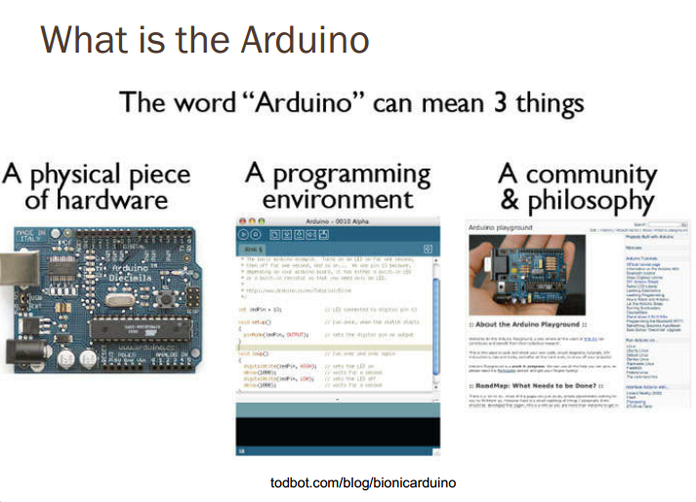

Slide 9
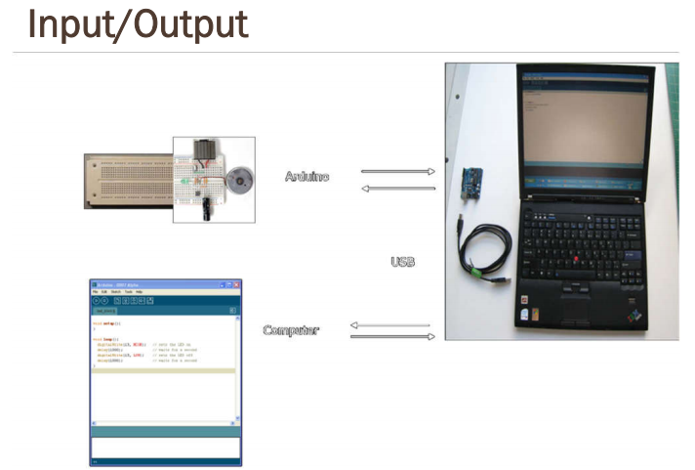

Slide 10
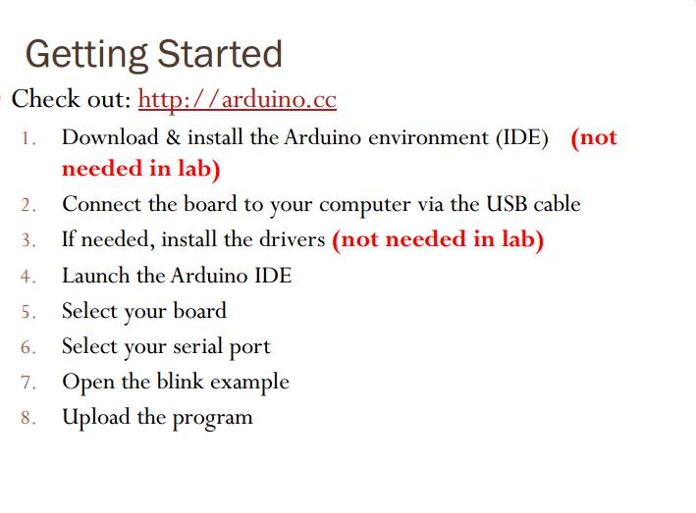

Slide 11
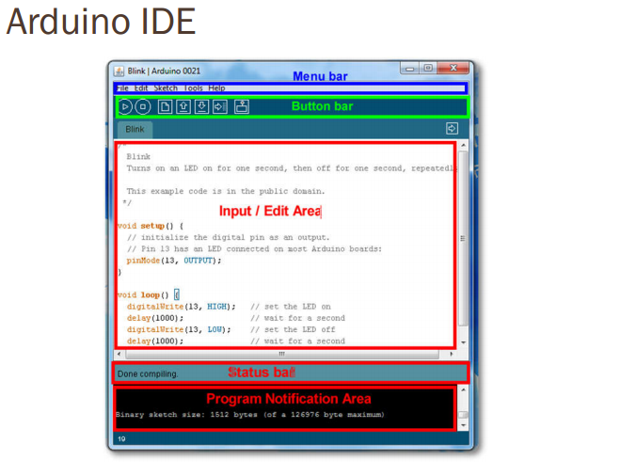

Slide 12
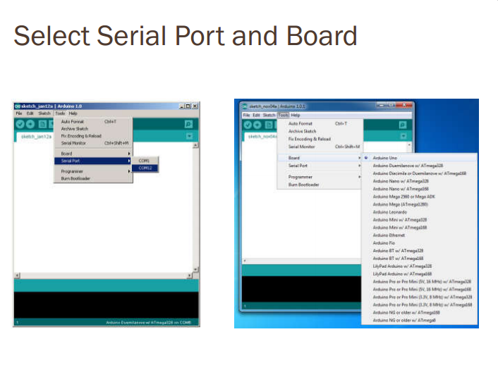

Slide 13
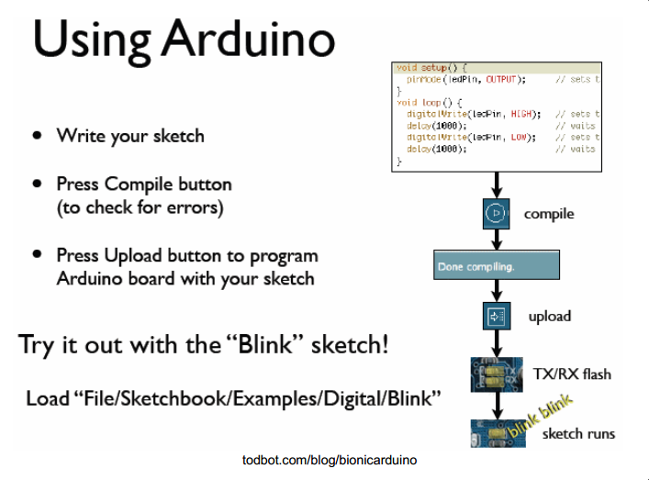

Slide 14


Slide 15


Slide 16
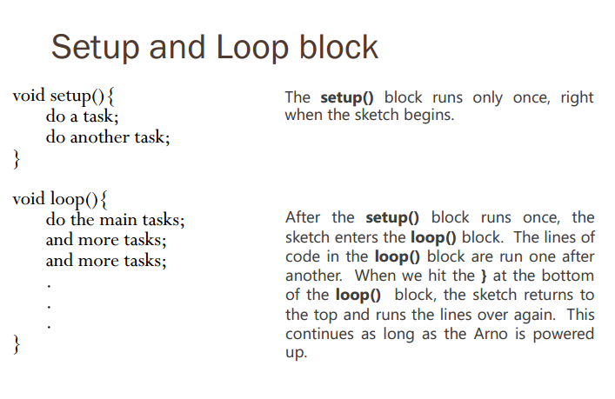

Slide 17
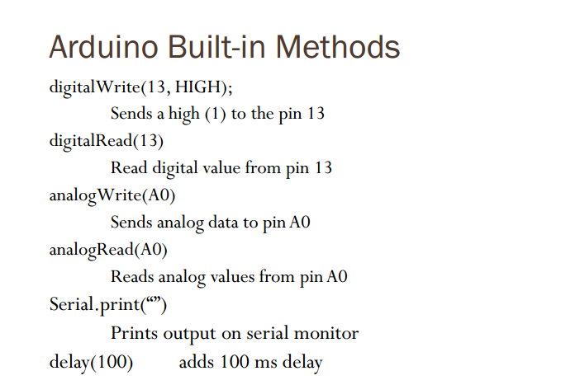

Slide 18
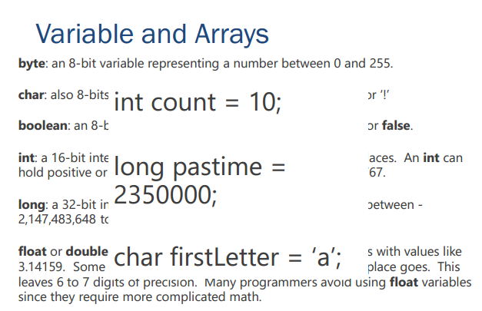

Slide 19
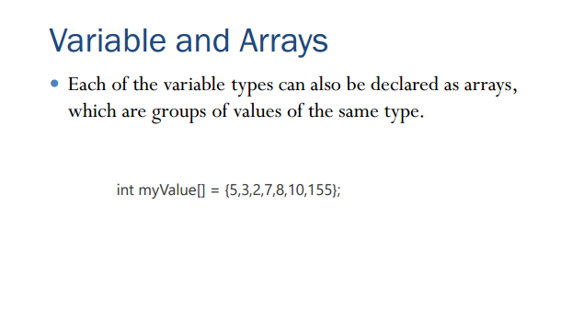

Slide 20
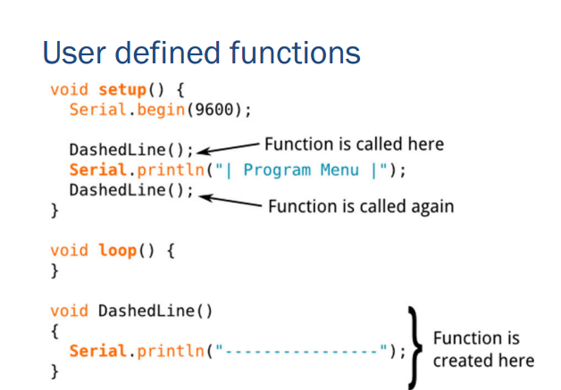

Slide 21
Switches
An electrical switch is any device used to interrupt the flow of electrons in a circuit. Switches are essentially binary devices: they are either completely on (“closed”) or completely off (“open”).

Slide 22

Types of Switches

Slide 23
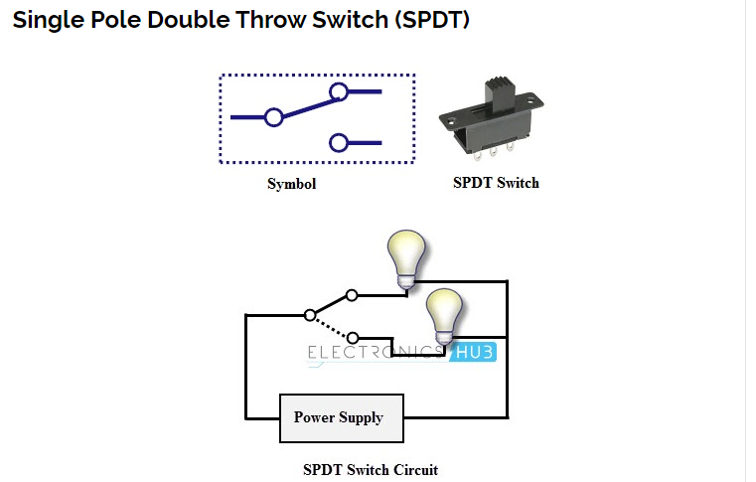

Slide 24
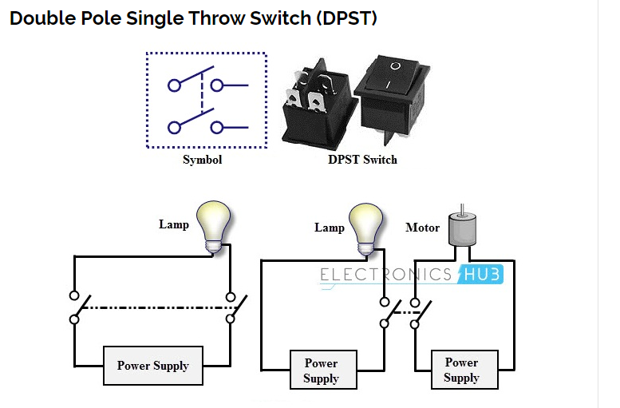

Slide 25
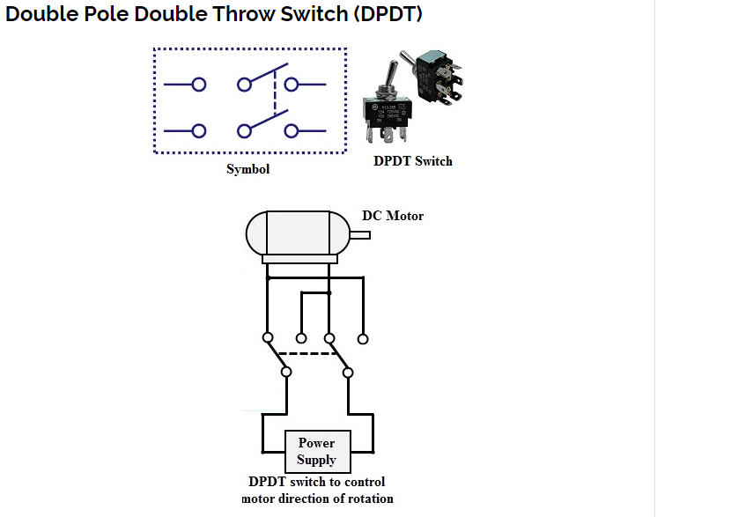

Slide 26
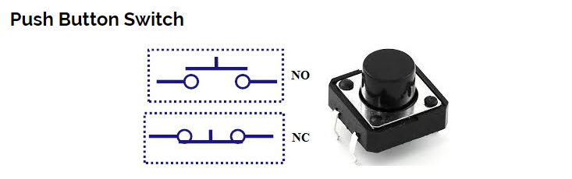

Slide 27


Slide 28
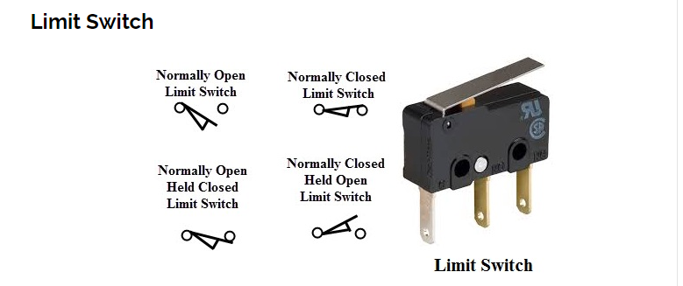
Float Switch
Flow Switch
Pressure Switch
Temperature Switch

Slide 29
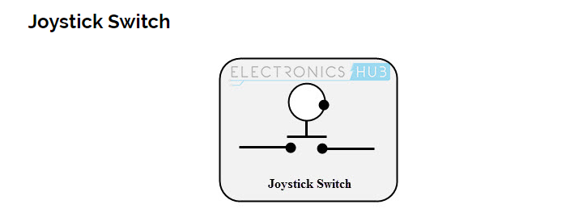
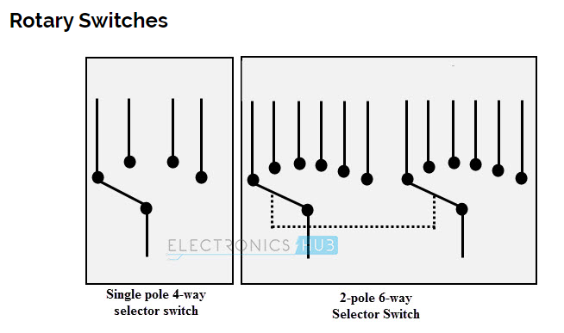

Slide 30
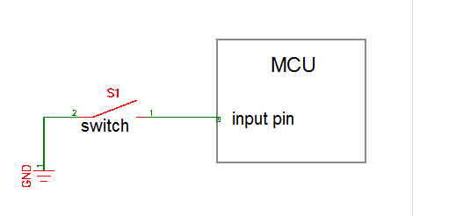
How to connect Switch with your MCU Wrong Approach

Slide 31
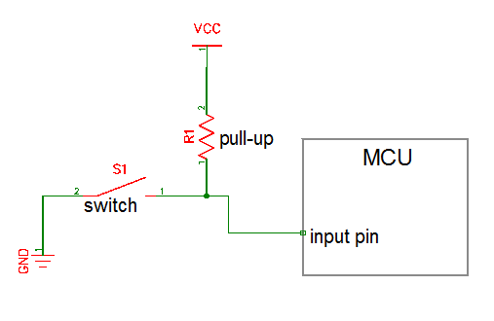
Pull Up Resistor

Slide 32
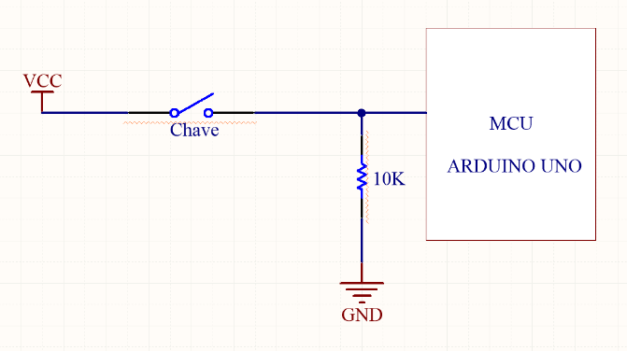
Pull Down Resistor

Slide 33
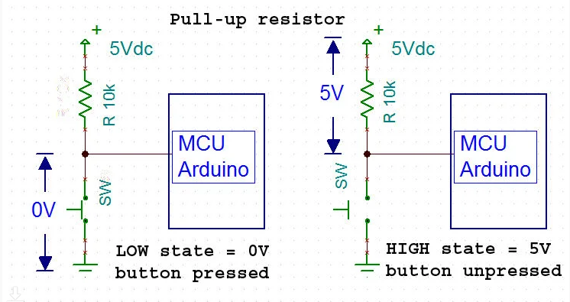

Slide 34
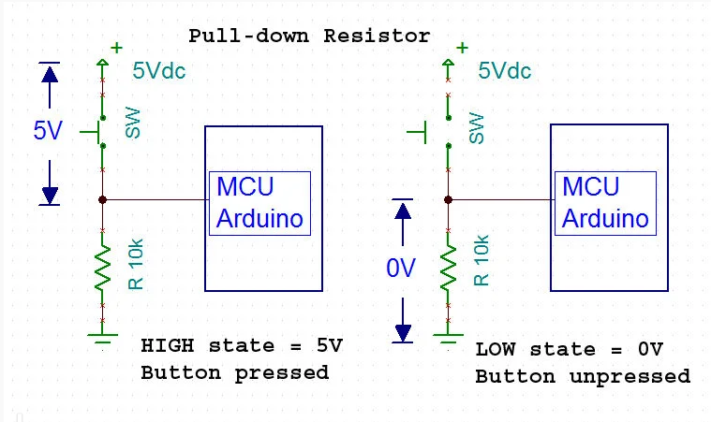

Slide 35
Practice Task
Connect RGB LED with your Arduino board and a push button. Write a program when the button is pressed RED LED will glow otherwise Green LED will glow.
(MAX time: 15-20 MIN)

